Slide 1
Getting Started with Android APIs
Ivan Wong

Slide 2
Motivation
“Datasheet”
Recently exposed to what’s available in Android
So let’s see what API’s are available

Slide 3
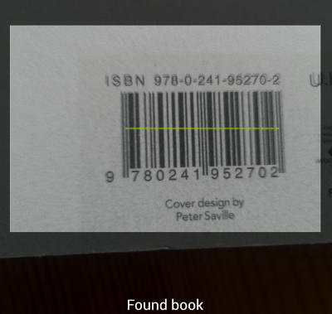
Integrating Barcode Scanner
http://code.tutsplus.com/tutorials/android-sdk-create-a-barcode-reader--mobile-17162

Slide 4
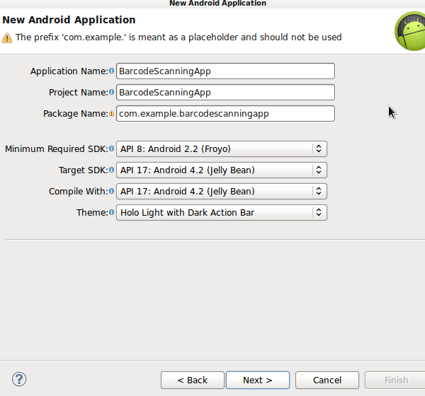
Step 1: Create new App

Slide 5
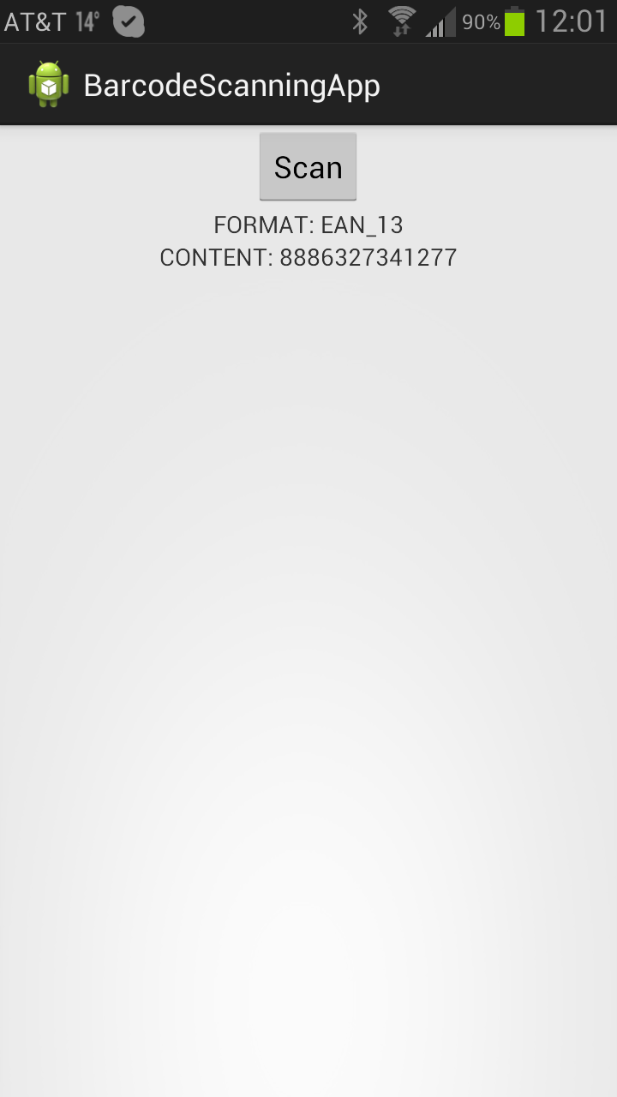
Create Text Fields and Two Buttons
<RelativeLayout xmlns:android="http://schemas.android.com/apk/res/android"
xmlns:tools="http://schemas.android.com/tools"
android:layout_width="match_parent"
android:layout_height="match_parent" >
<Button android:id="@+id/scan_button"
android:layout_width="wrap_content"
android:layout_height="wrap_content"
android:layout_centerHorizontal="true"
android:text="@string/scan" />
</RelativeLayout>
<TextView
android:id="@+id/scan_format"
android:layout_width="wrap_content"
android:layout_height="wrap_content"
android:textIsSelectable="true"
android:layout_centerHorizontal="true"
android:layout_below="@id/scan_button" />
<TextView
android:id="@+id/scan_content"
android:layout_width="wrap_content"
android:layout_height="wrap_content"
android:textIsSelectable="true"
android:layout_centerHorizontal="true"
android:layout_below="@id/scan_format" />
<string name="scan">Scan</string>

Slide 6
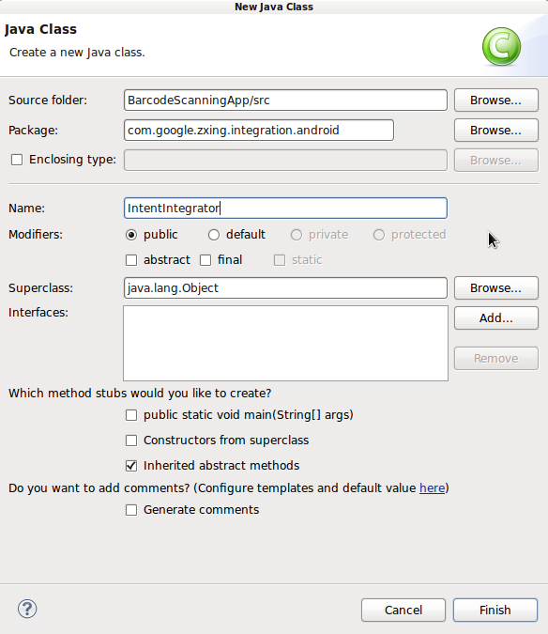
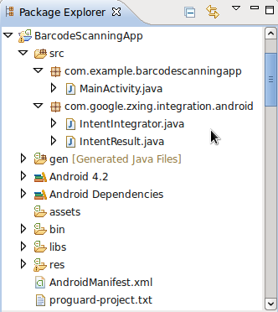
Add Zebra Crossing (ZXING) from GitHub
https://code.google.com/p/zxing/source/browse/trunk/android-integration/src/com/google/zxing/integration/android/?r=2002

Slide 7
@Override for Oncreate
private Button scanBtn;
private TextView formatTxt, contentTxt;
@Override
protected void onCreate(Bundle savedInstanceState) {
super.onCreate(savedInstanceState);
setContentView(R.layout.activity_main);
scanBtn = (Button)findViewById(R.id.scan_button);
formatTxt = (TextView)findViewById(R.id.scan_format);
contentTxt = (TextView)findViewById(R.id.scan_content);
scanBtn.setOnClickListener(this);
}
public void onActivityResult(int requestCode, int resultCode, Intent intent) {
//retrieve scan result
IntentResult scanningResult = IntentIntegrator.parseActivityResult(requestCode, resultCode, intent);
if (scanningResult != null) {
//we have a result
String scanContent = scanningResult.getContents();
String scanFormat = scanningResult.getFormatName();
formatTxt.setText("FORMAT: " + scanFormat);
contentTxt.setText("CONTENT: " + scanContent);
}
else{
Toast toast = Toast.makeText(getApplicationContext(),
"No scan data received!", Toast.LENGTH_SHORT);
toast.show();
}
public void onClick(View v){
//respond to clicks
if(v.getId()==R.id.scan_button){
//scan
IntentIntegrator scanIntegrator = new IntentIntegrator(this);
scanIntegrator.initiateScan();
}

Slide 8
What can this be used for?
Integrating barcode scanning into your own application using ZXING library.
Learning how to use open-source APIs which can help you in your app-development career.

Slide 9
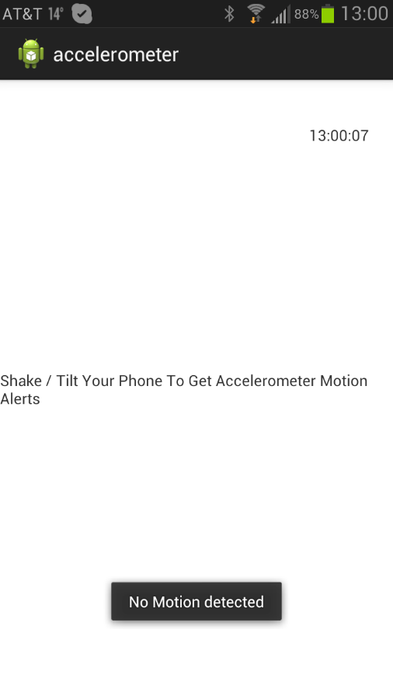
Quick look at using built in Accels
http://androidexample.com/Accelerometer_Basic_Example_-_Detect_Phone_Shake_Motion/index.php?view=article_discription&aid=109&aaid=131
Detecting phone movements (jerk)
<RelativeLayout xmlns:android="http://schemas.android.com/apk/res/android"
xmlns:tools="http://schemas.android.com/tools"
android:layout_width="match_parent"
android:layout_height="match_parent"
tools:context=".MainAccelerometer" >
<TextView
android:layout_width="wrap_content"
android:layout_height="wrap_content"
android:layout_centerHorizontal="true"
android:layout_centerVertical="true"
android:text="Shake / Tilt Your Phone To Get Accelerometer Motion Alerts" />
</RelativeLayout>

Slide 10
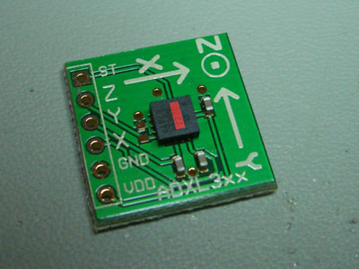
MainAccel.java
public void onShake(float force) {
// Do your stuff here
// Called when Motion Detected
Toast.makeText(getBaseContext(), "Motion detected",
Toast.LENGTH_SHORT).show();
}
@Override
public void onResume() {
super.onResume();
Toast.makeText(getBaseContext(), "onResume Accelerometer Started",
Toast.LENGTH_SHORT).show();
//Check device supported Accelerometer senssor or not
if (AccelerometerManager.isSupported(this)) {
//Start Accelerometer Listening
AccelerometerManager.startListening(this);
}}
http://protolab.pbworks.com/f/1172890711/accel-01.jpg
@Override
public void onStop() {
super.onStop();
//Check device supported Accelerometer senssor or not
if (AccelerometerManager.isListening()) {
//Start Accelerometer Listening
AccelerometerManager.stopListening();
Toast.makeText(getBaseContext(), "onStop Accelerometer Stoped",
Toast.LENGTH_SHORT).show();
}}

Slide 11
Listener
public interface AccelerometerListener {
public void onAccelerationChanged(float x, float y, float z);
public void onShake(float force);
}

Slide 12
private static SensorEventListener sensorEventListener =
new SensorEventListener() {
public void onAccuracyChanged(Sensor sensor, int accuracy) {}
public void onSensorChanged(SensorEvent event) {
now = event.timestamp;
x = event.values[0];
y = event.values[1];
z = event.values[2];
// if not interesting in shake events
// just remove the whole if then else block
if (lastUpdate == 0) {
lastUpdate = now;
lastShake = now;
lastX = x;
lastY = y;
lastZ = z;
Toast.makeText(aContext,"No Motion detected",
Toast.LENGTH_SHORT).show();
} else {
timeDiff = now - lastUpdate;
if (timeDiff > 0) {
/*force = Math.abs(x + y + z - lastX - lastY - lastZ)
/ timeDiff;*/
force = Math.abs(x + y + z - lastX - lastY - lastZ);
if (Float.compare(force, threshold) >0 ) {
//Toast.makeText(Accelerometer.getContext(),
//(now-lastShake)+" >= "+interval, 1000).show();
if (now - lastShake >= interval) {
// trigger shake event
};
listener.onShake(force);
}
else
{
Toast.makeText(aContext,"No Motion detected",
Toast.LENGTH_SHORT).show();
}
lastShake = now;
}
lastX = x;
lastY = y;
lastZ = z;
lastUpdate = now;
}
else
{
Toast.makeText(aContext,"No Motion detected", Toast.LENGTH_SHORT).show();
}
}
// trigger change event
listener.onAccelerationChanged(x, y, z);
}

Slide 13
Applications?
For you to be creative! ☺

